Slide 1
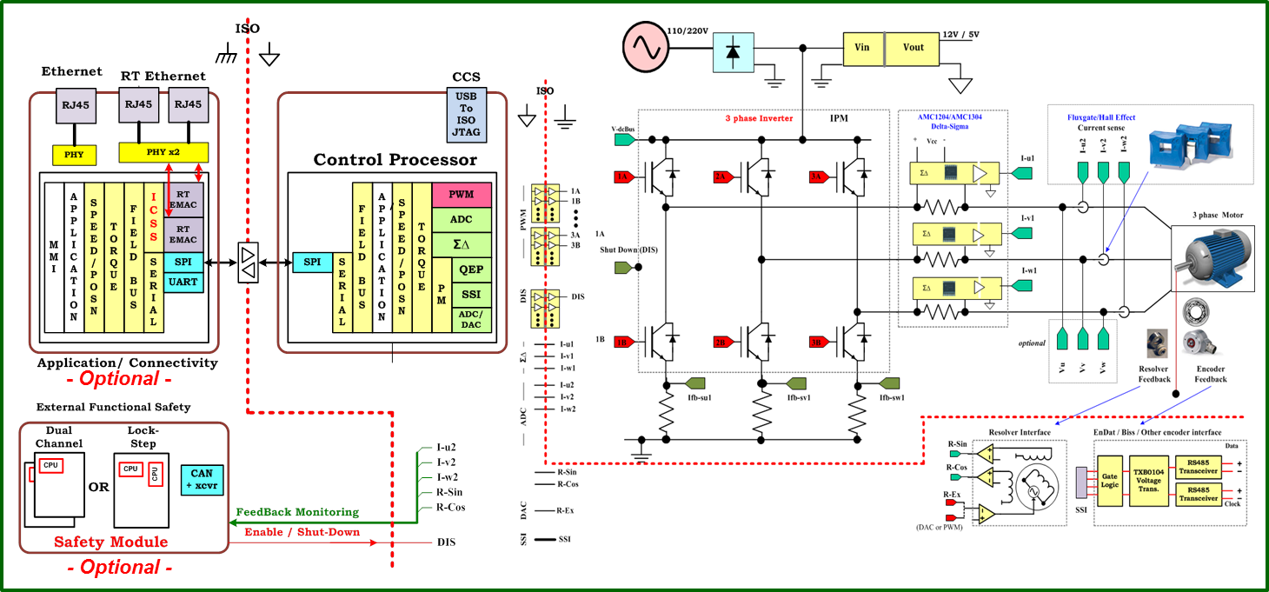

TMS320F2837xD
PMSM Servo

Slide 2
TMDXIDDK379D
TMS320F2837xD
PMSM Servo

Slide 3
Design
Specifications
Requirements
Hardware
+
Software
Analysis
Model of Real System
Sub-models
Closed loops specs.
Functions
State flow
Implementation
SIL + HIL
Test
Verification
Generated Code

